Slide 1

Preparedness Kits
OSU Emergency Preparedness
emergency@oregonstate.edu

Slide 2


How Long?
Space holder
Space holder
vs.
oregon.gov/oem

Slide 3
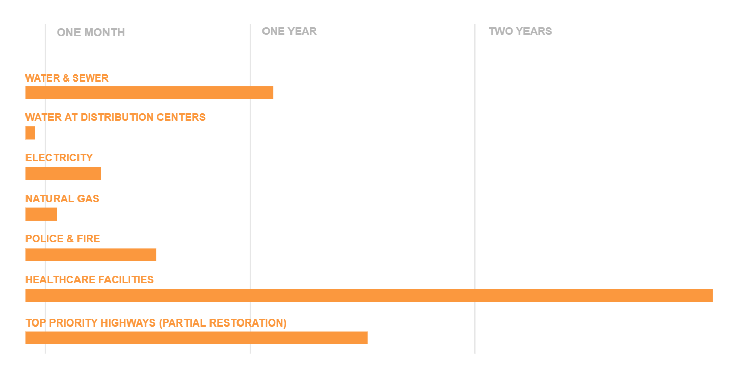
Recovery of Services
Cascadia Earthquake
Corvallis, Oregon

Slide 4
In Oregon
Oregon’s Office of Emergency Management
“2 Weeks Ready”
Due to Cascadia Subduction Zone
  Transportation routes destroyed – in and out
  Tsunami
72 hour kit
  Weather
  Power outages
  Temporary evacuation
2 weeks covers all bases
oregon.gov/oem

Slide 5





Use Rule of Threes to guide planning
You can live –
3 seconds without blood
3 minutes without air
3 hours without shelter
3 days without water
3 weeks without food

Slide 6

Rule of Two

Slide 7
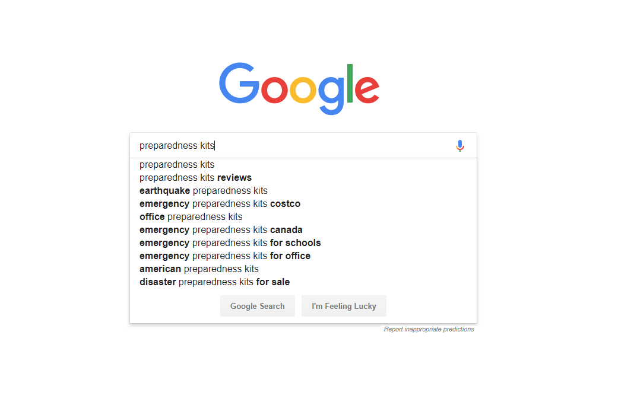
Pre-made Kits

Slide 8

Pre-made kits

Slide 9
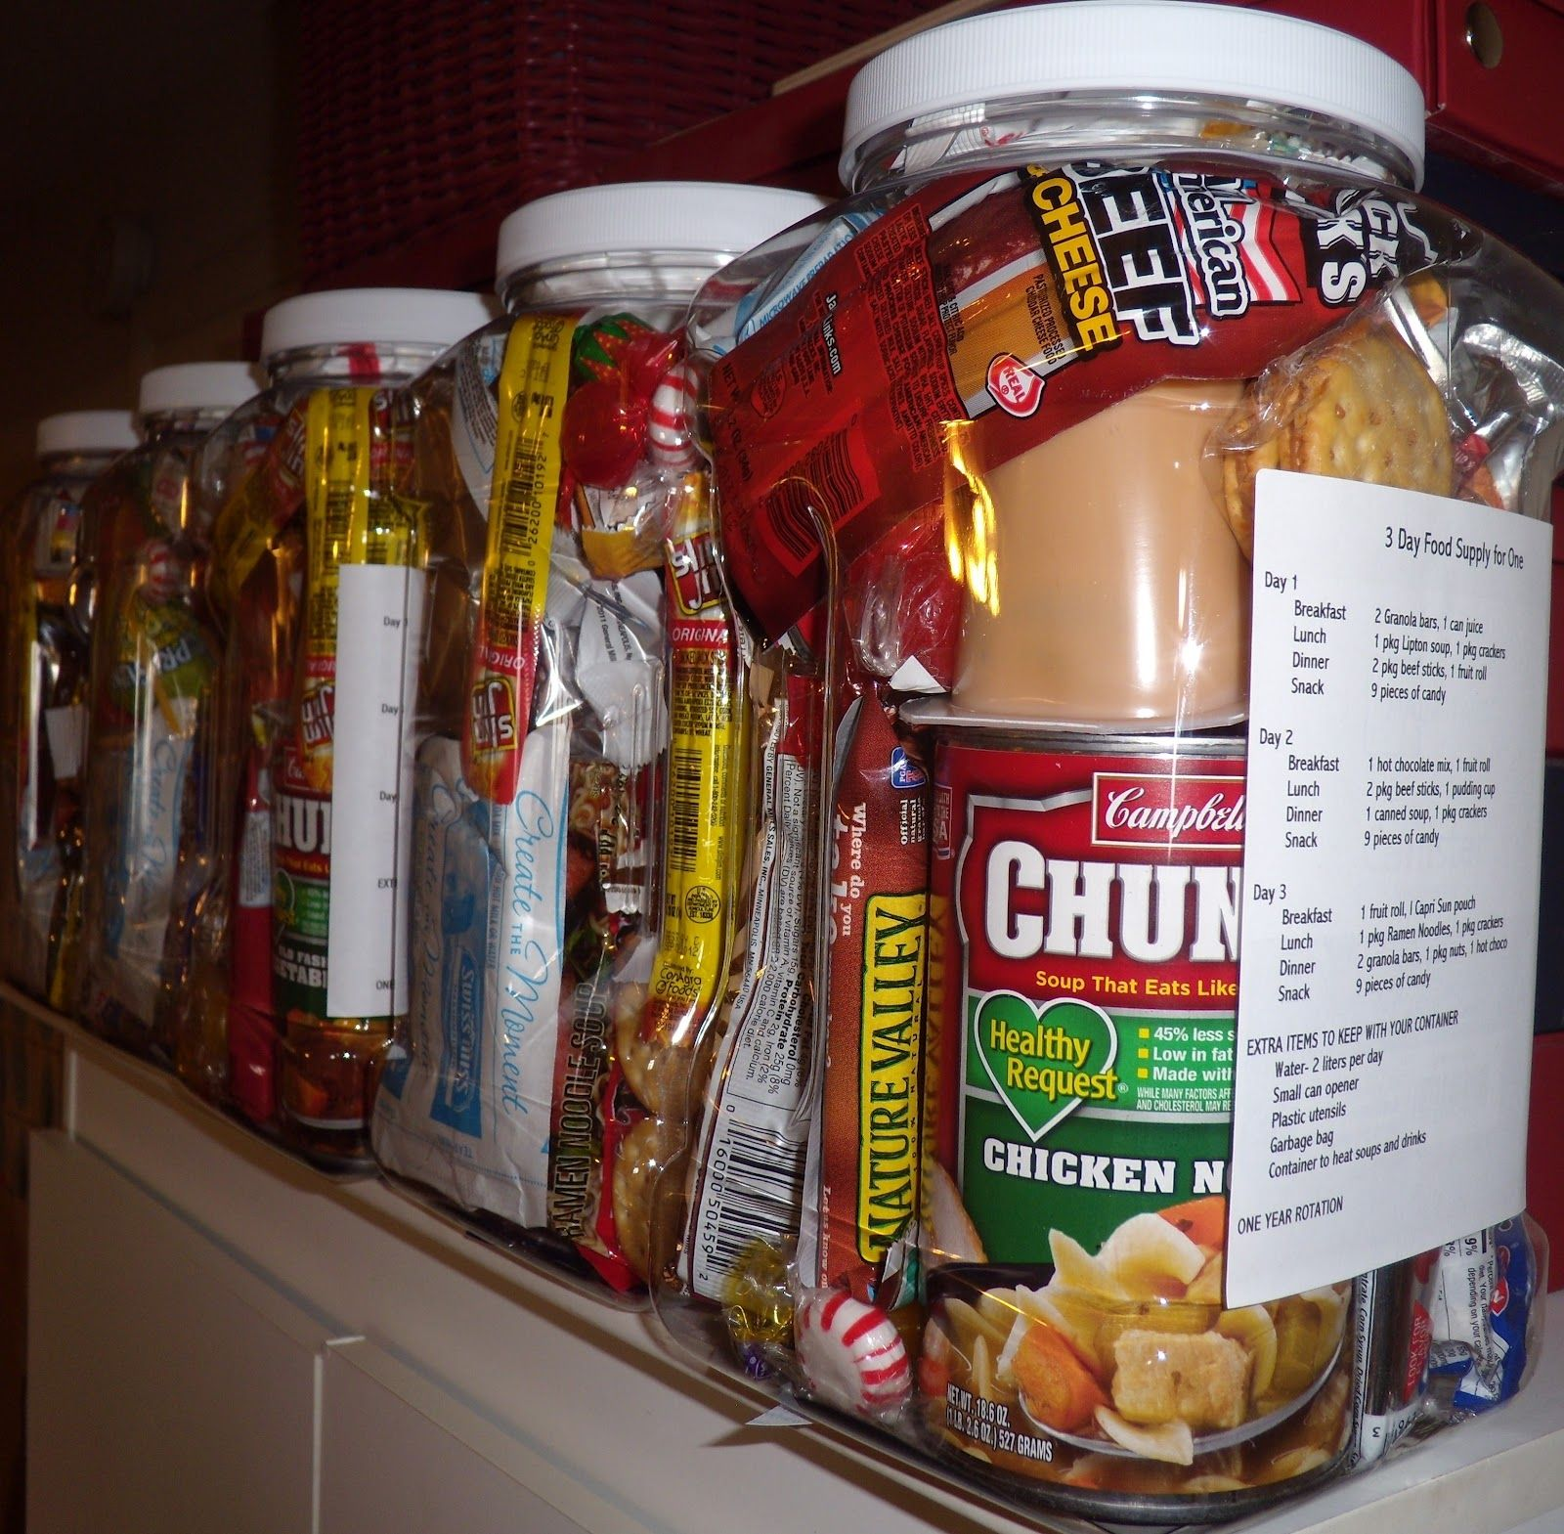
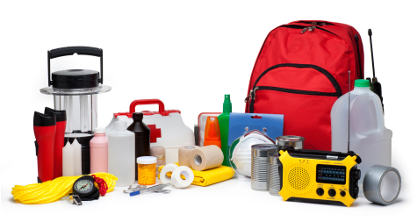
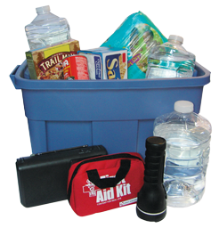
Build Your Own
One of the best options is to build your own kit. Stating with the staples and adding as needed.

Slide 10
Build Your Own
Import considerations when making a kit:
Your specific needs
Climate of storage area
Budget
Knowledge of items and uses
Flexibility

Slide 11
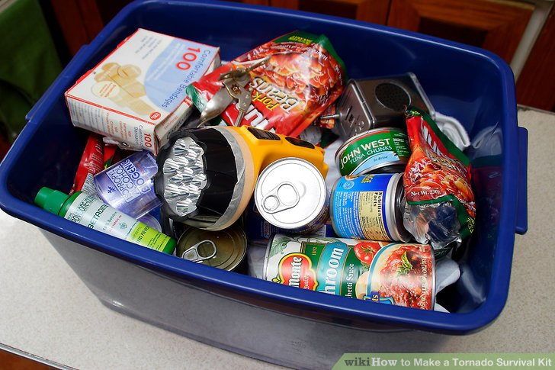
Who’s Using The Kit?
One person
Single family
Household
Extended family
Neighborhoods
Coworkers
Community

Slide 12
What We Need to Consider
Somethings
Something for your somethings
Somewhere for your somethings’, something

Slide 13

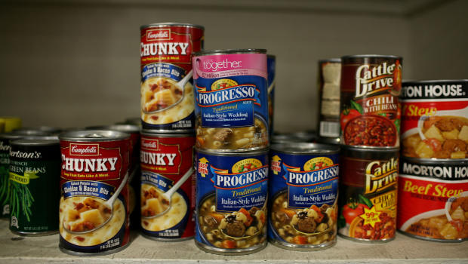
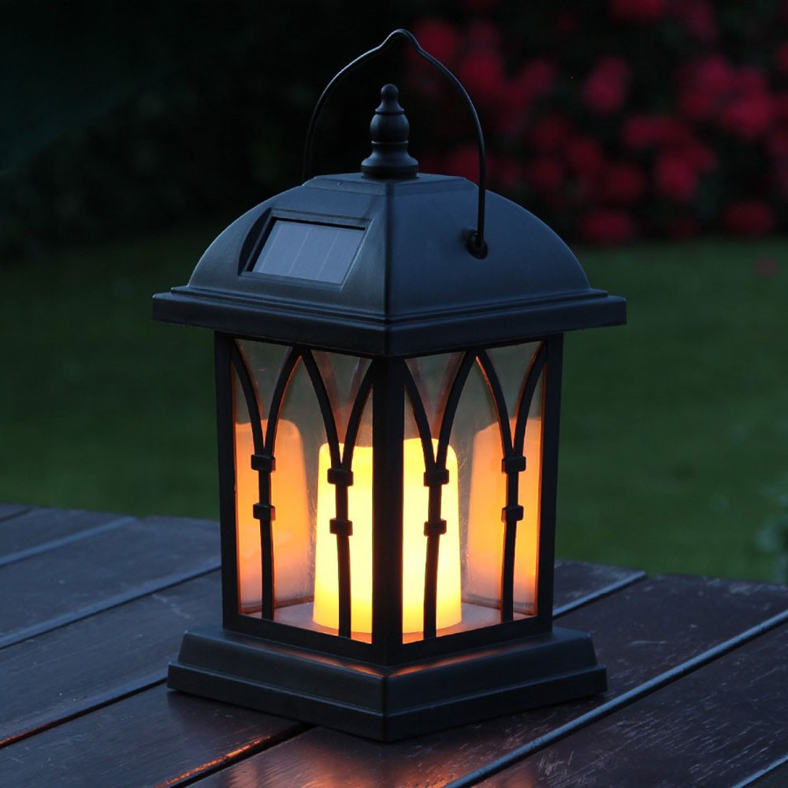
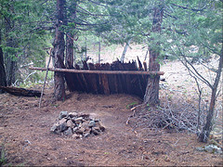
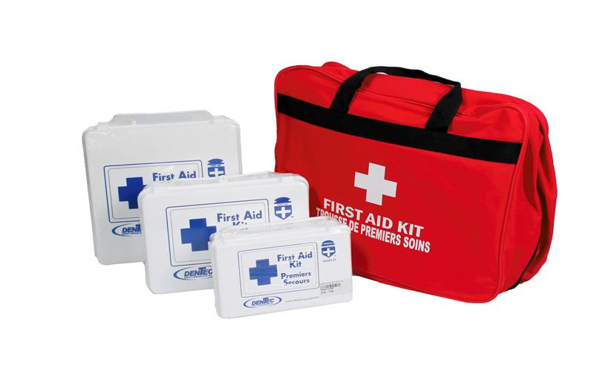
1. Somethings (Items)
Look at the Basics First:
Light
Shelter
Warmth
Water
Food
Safety (First-aid/medication)

Slide 14
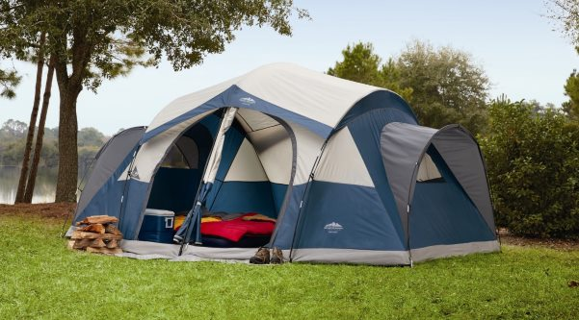
Long Term Camping
One way to think of kits is to think of it as long term camping
What do I need for a 3-day camping trip?
For a 2-week camping trip?
Longer?

Slide 15
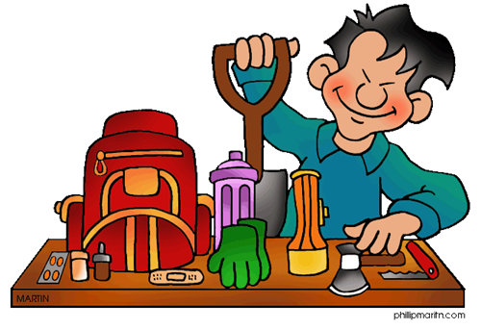
72 Hour Kit
What do you need for 3 days?
Flashlights
Pry bar
Food
Water
Toiletries
Radio
Emergency blankets
Whistles
Gloves
Ponchos
First aid kits
Toilet
Fire starters
Shelter
Sleeping bag(s)

Slide 16

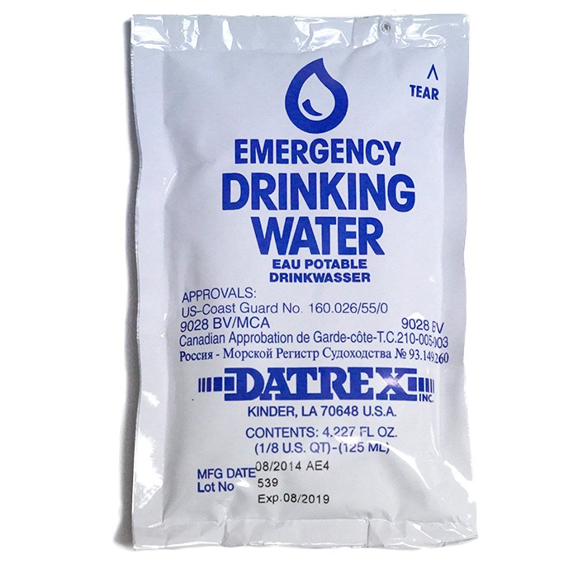
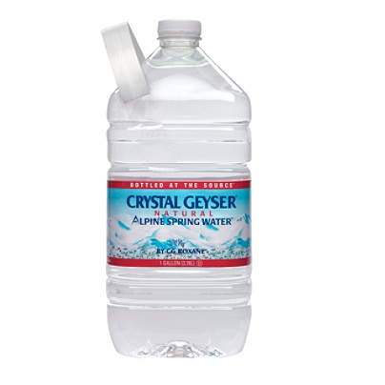
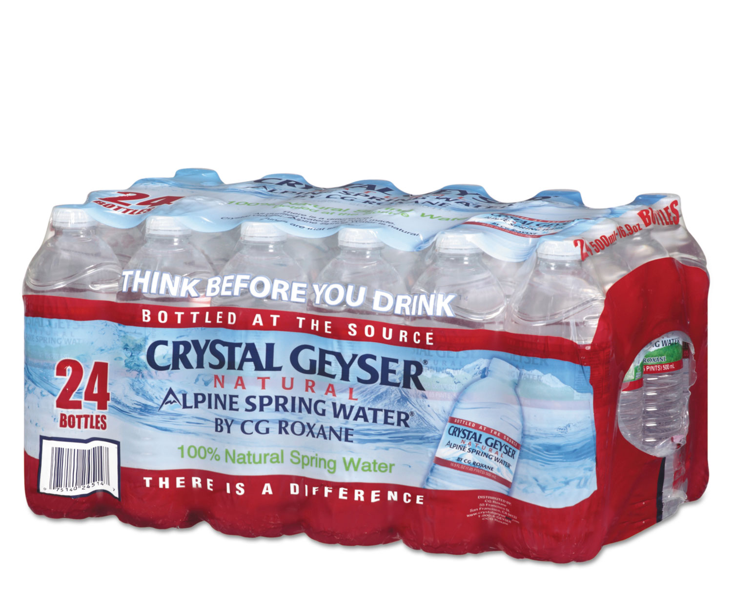
Water
Plan for 14 days / 30 days if on Coast
1 gallon per person per day (and 1 gallon per pet per day)
  Hygiene
  Cooking
  First Aid
  Drinking
Storage of water
  1 gallon = 8.3 pounds

Slide 17
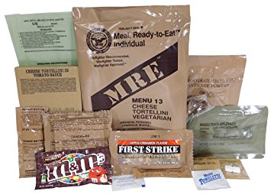


Food
Plan for a mix of food types
  No cook – eat out of wrapper
    Canned goods
    MREs
    Food bars
  Rehydrate – can still be eaten without heat
    Dehydrated
    Freeze dried
  Cook
    Needed to kill germs/bacteria
Eat Refrigerator and freezer first
  Ice Cream
  Meat, fish, ice cream, etc.
  Milk, cheese, deli meat, eggs, etc.
  Fruits and veggies
  Breads
  Pasta, rice, longer self-life items
  Canned food
  Emergency food from storage

Slide 18
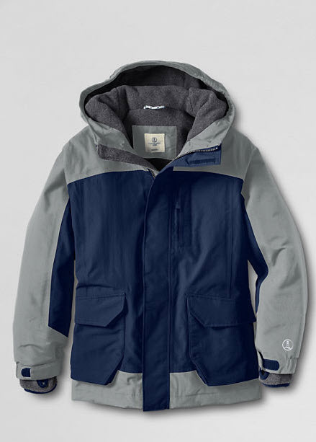

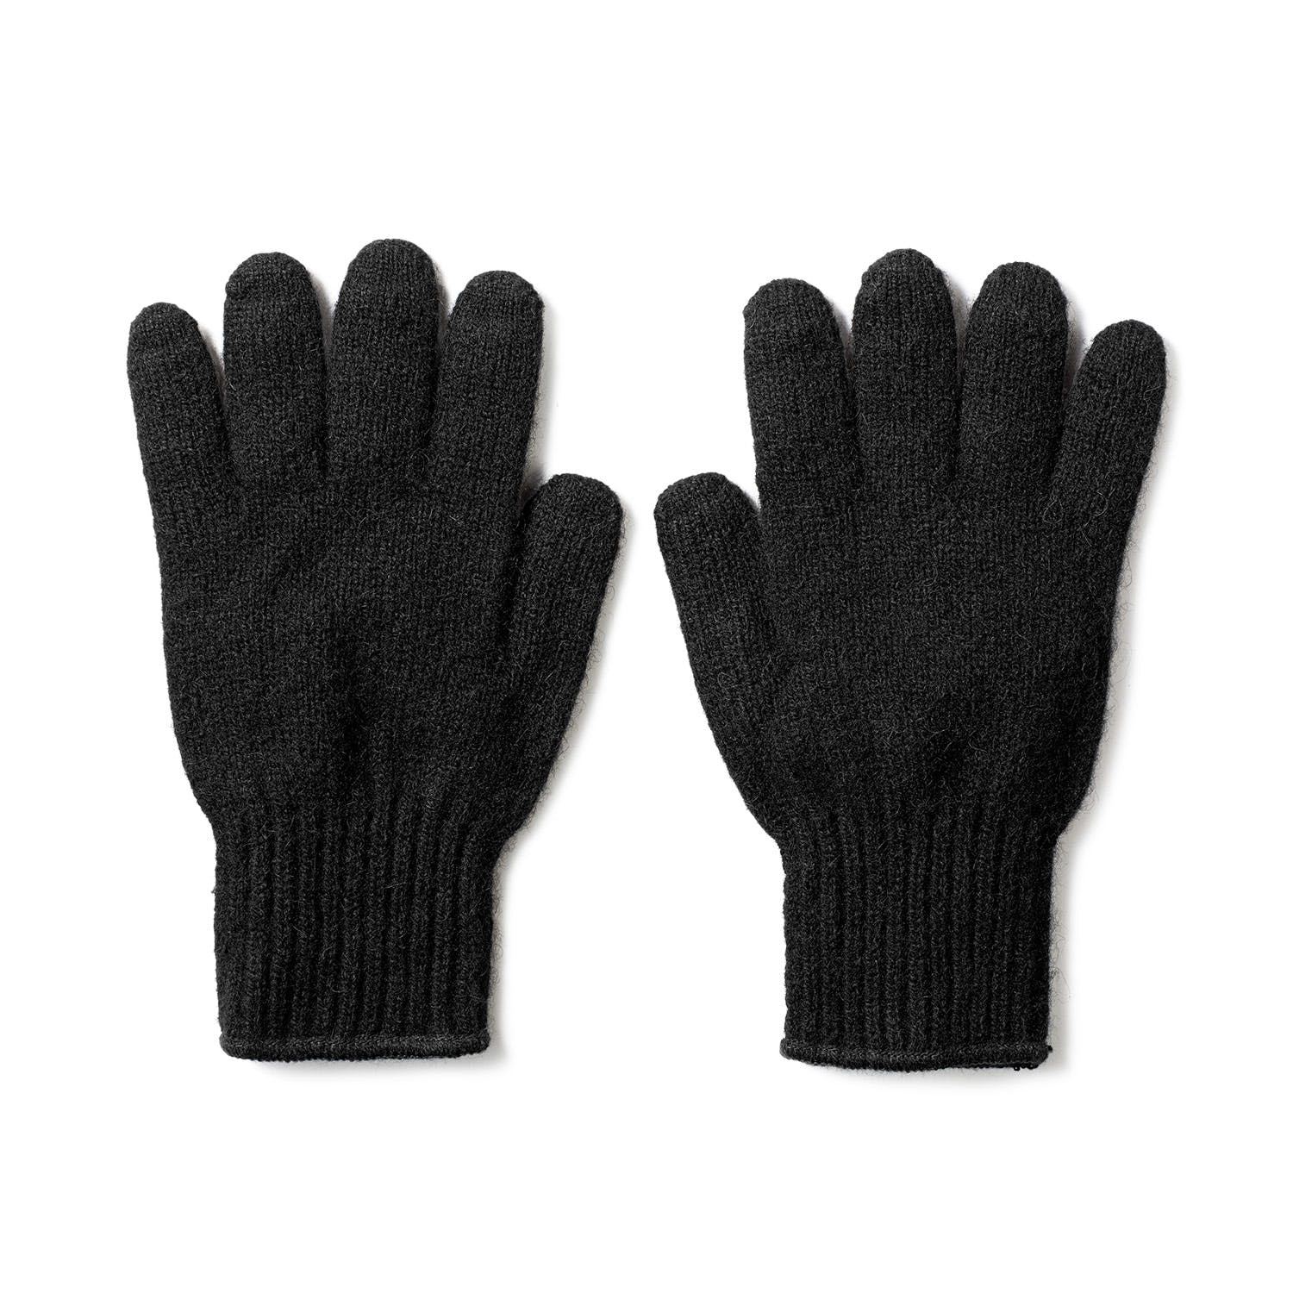
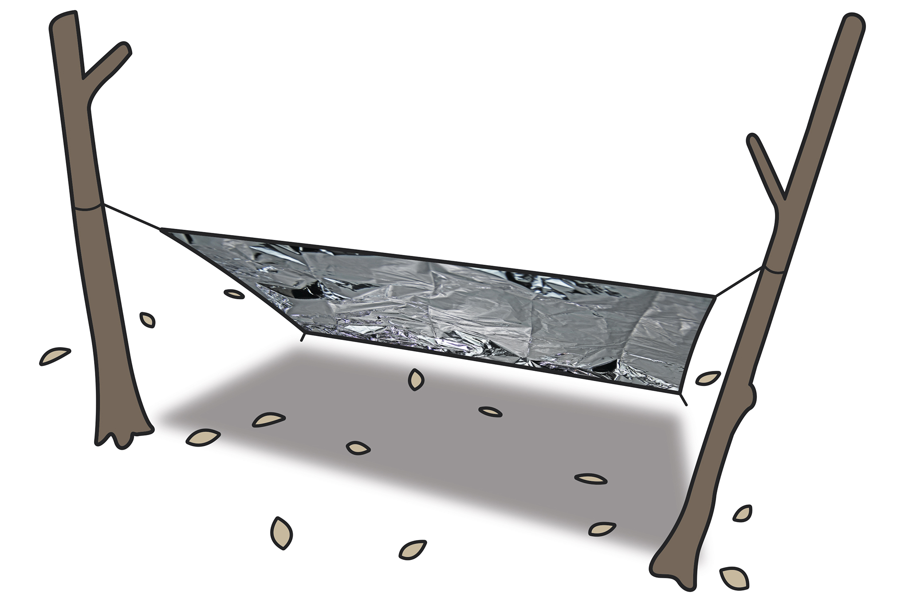
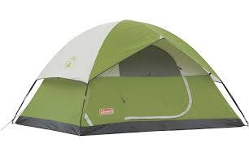
Shelter
Clothing
  Warm
  Dry
  Seasonal
Sleeping and living
  Community shelter
  Tarp, Tent, Canopy
For each family member
  Change sizes as growth continues!
  Pack in plastic bags to keep dry
Emergency Shelter
  Poncho
  Space blanket (mylar)
  Tree boughs

Slide 19
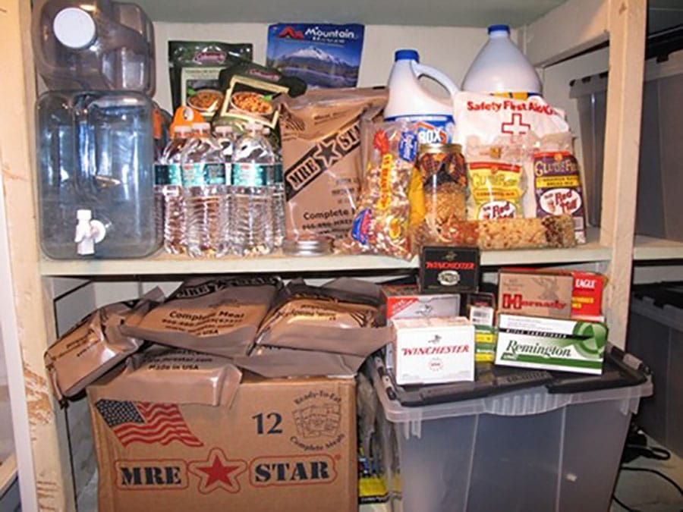
Main 2-Week Kit
Use with 72-hour kit
Should be accessible
Should be somewhat portable
This kit needs items for cooking
Add more, such as:
Larger tent/shelter
Water purification
Bedding
Food/Water

Slide 20
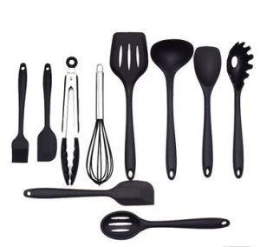
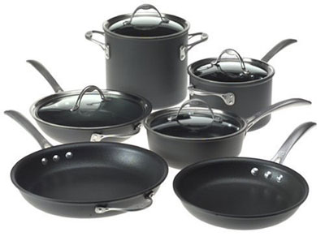
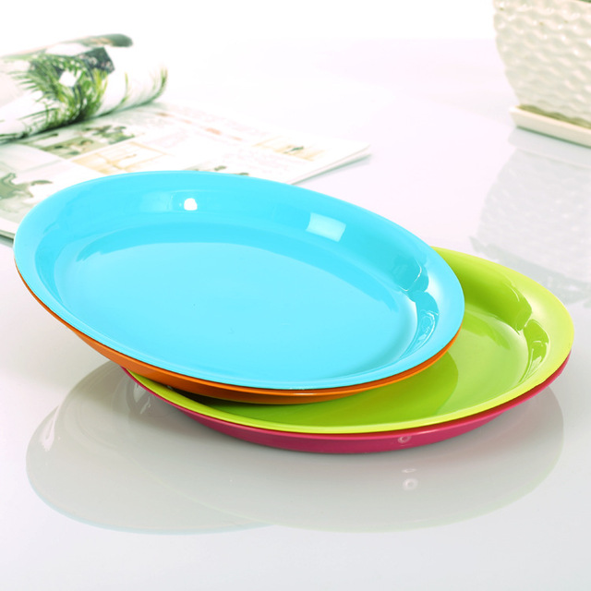
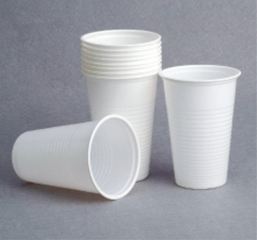
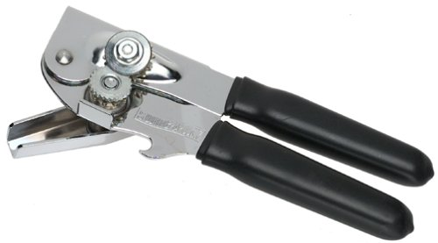
2-Week Kit – Don’t Forget

Slide 21
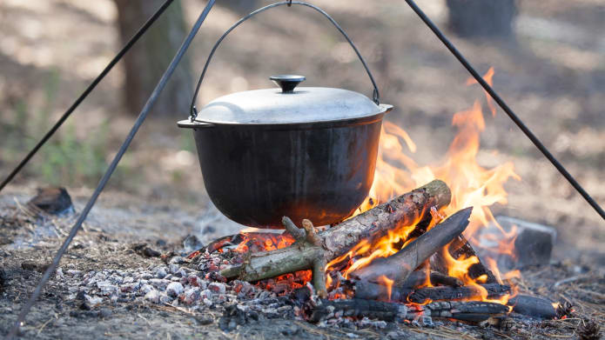
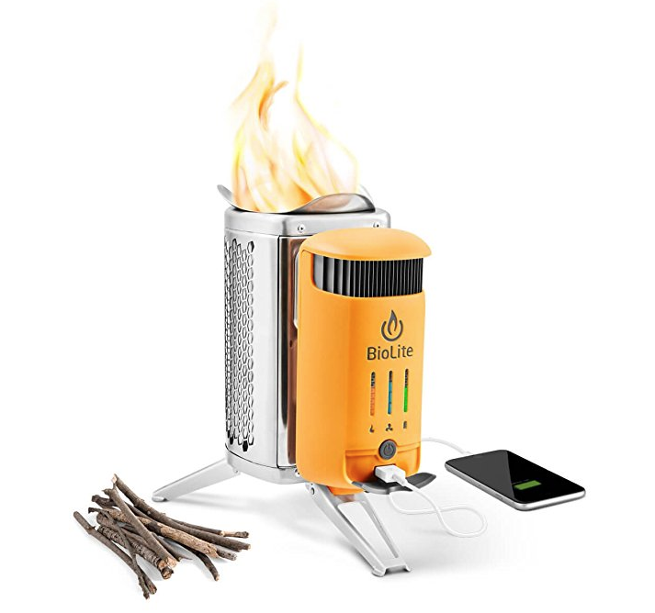
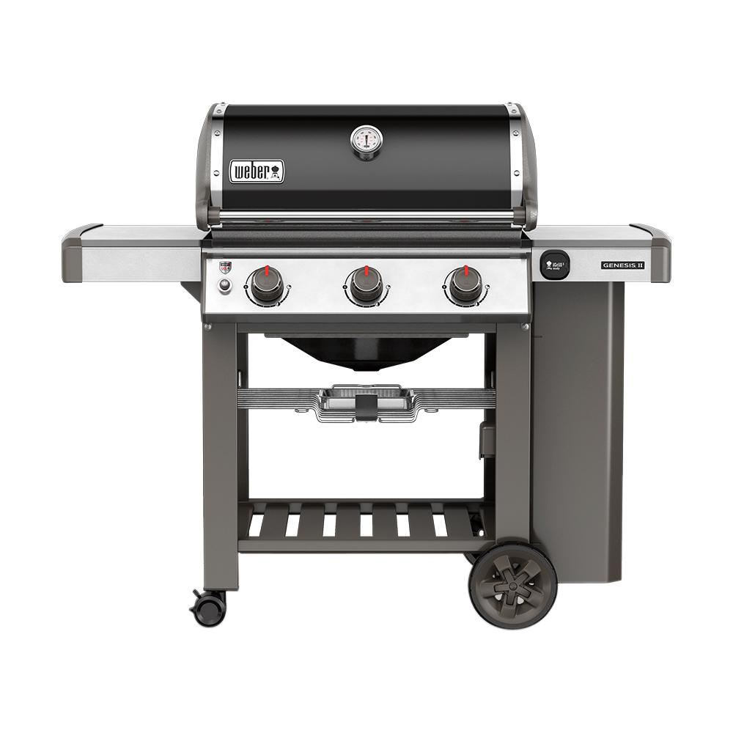
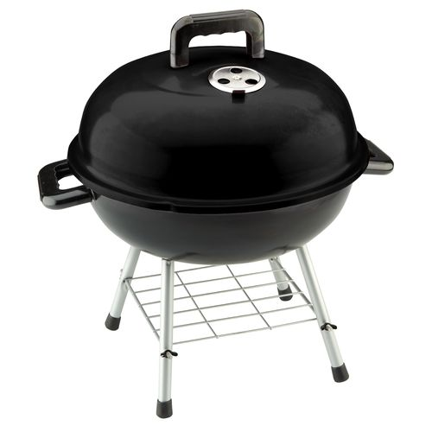
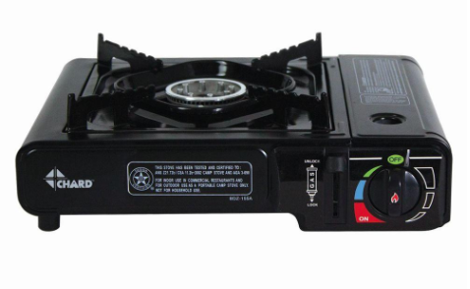
Heating/Cooking
Portable Cooking Bags - MREs
Folding Camp Stove
Portable Butane Stove
Propane Grill
Charcoal Grill
Open Fire
Solar Cooker
Built-in fireplace (if undamaged)

Slide 22
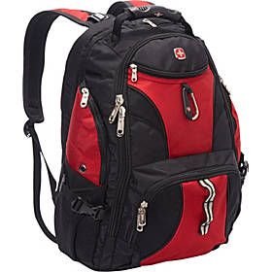
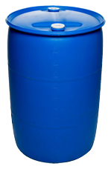
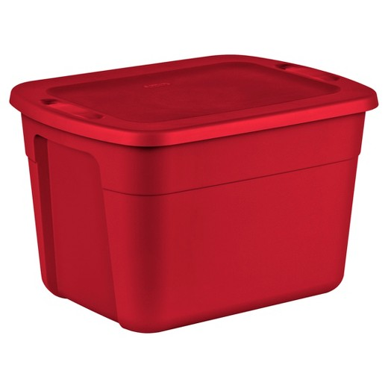
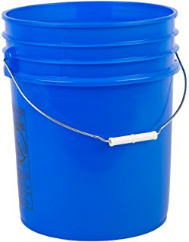
2. Containers
Something to keep your somethings
  Backpack
  Tub
  Drum
  Bucket
  Loose on shelves
Notes:
Tackle box
Fanny pack
Duffle bag

Slide 23
2. Containers
Something to keep your somethings
  Durable
  Crush resistant
  Portable
  Waterproof
  Dust resistant
  Animal resistant
  Weight considerations
Notes:
Tackle box
Fanny pack
Duffle bag

Slide 24
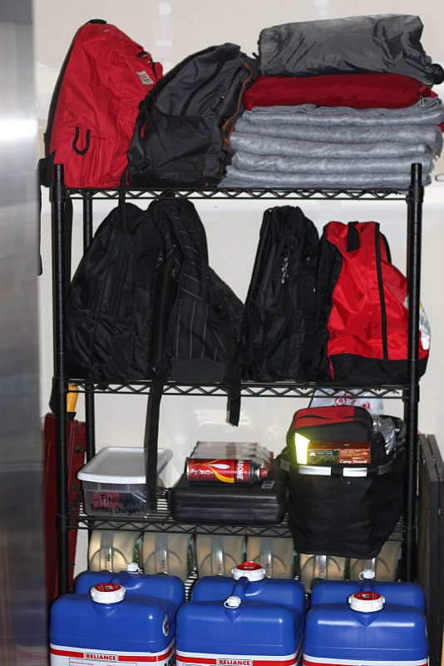
3. Container Storage
Somewhere to keep your something’s, something
  Takes a lot of space
  Do other know where the kit is
  If you’re not home
  Accessibility
  Organized
  Labeled
  Dated
  Reflective
Notes:
Multiple locations – cant access the main area

Slide 25
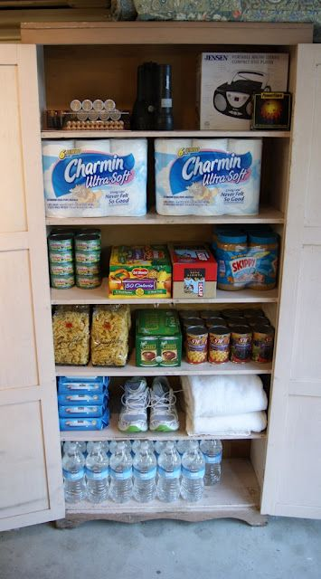
3. Container Storage
Can not gain access to kit
  Collapse
  Hazards
    Debris
    Fire
  No access to home
    Away from home
    Streets blocked off
  Kit destroyed
    Items broken

Slide 26
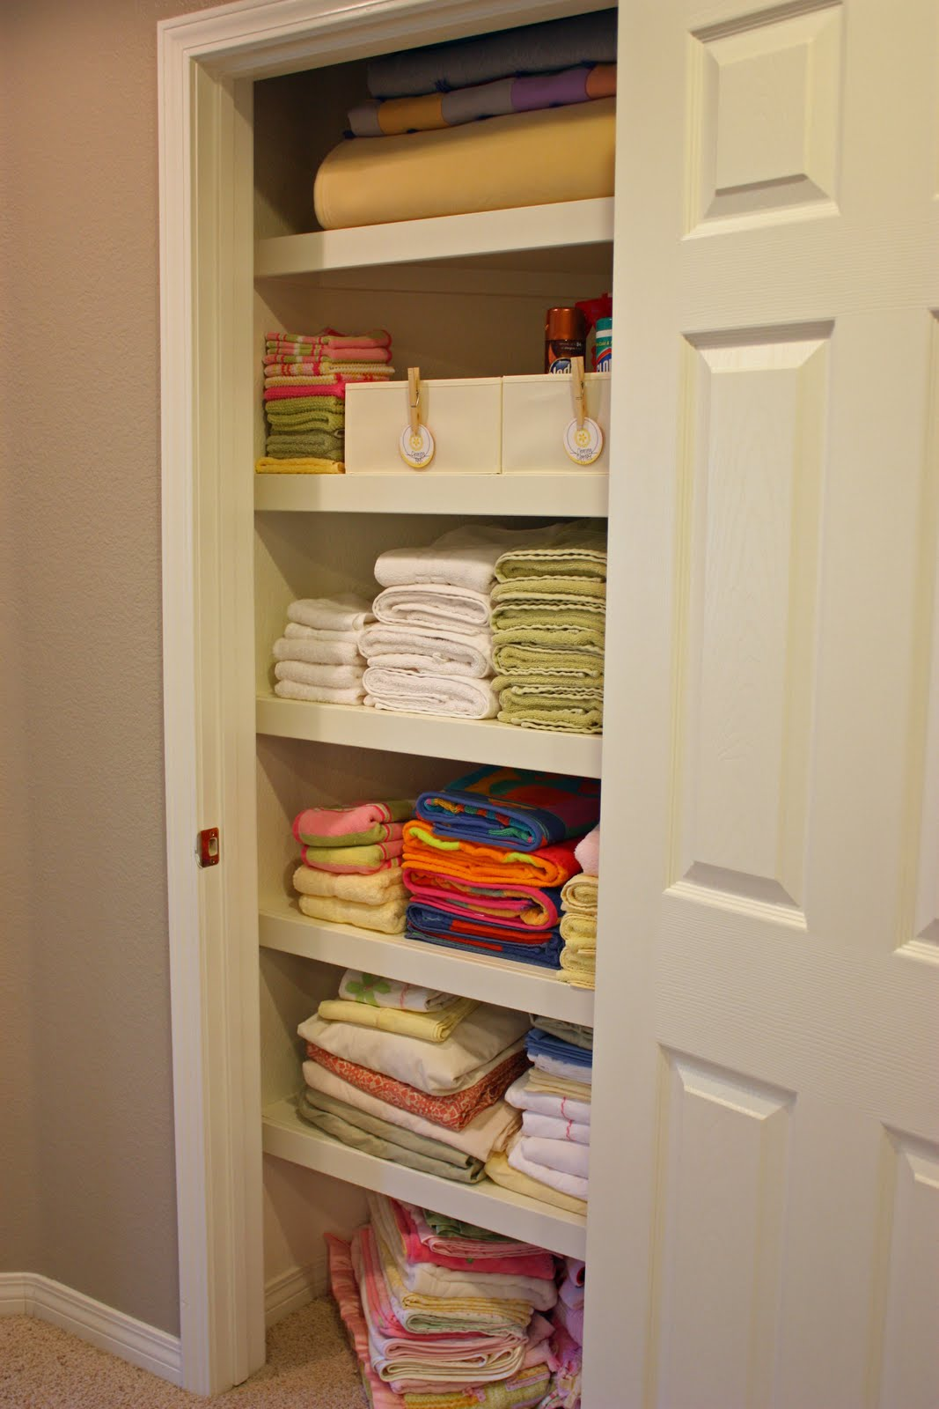
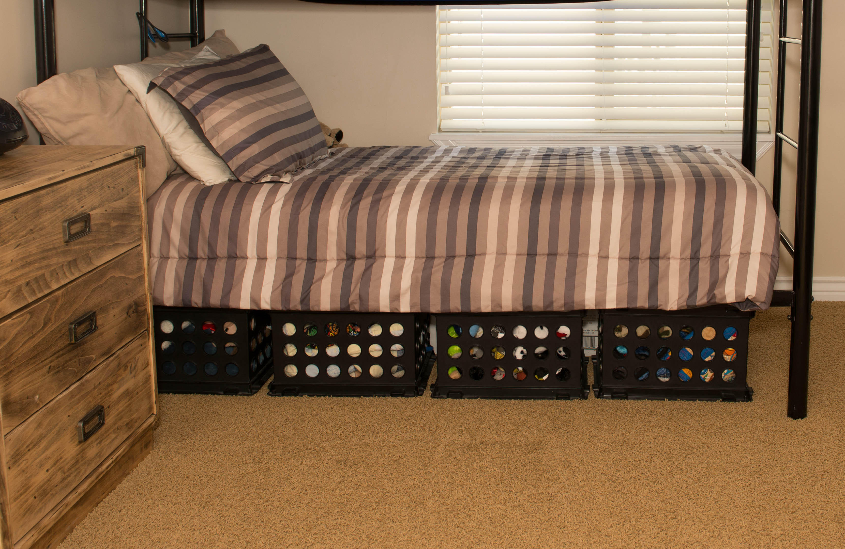
Get Creative with Storage
Pantry
Linen closet
Guestroom closet
Under bathroom sinks
Under beds
Under couches
Coat closet
Garage (last choice)

Slide 27
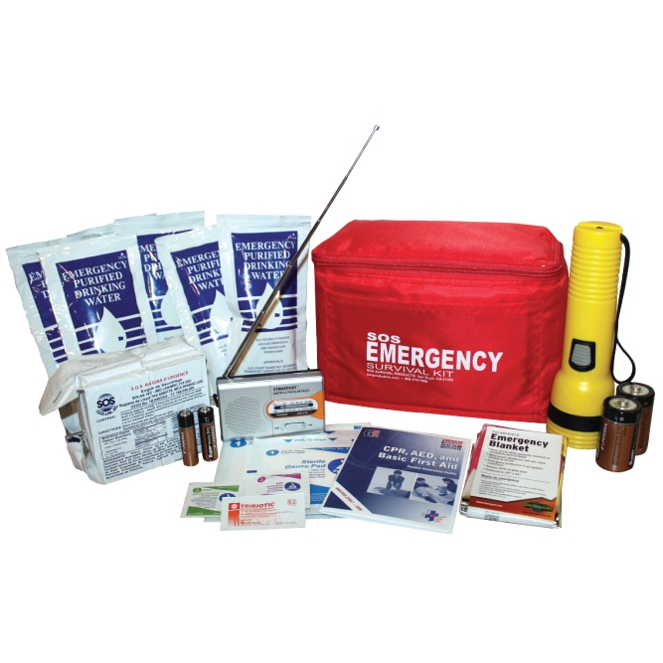
Personal Work/Office Kit
Stuck at work
Flashlight
Pry bar
Food/water
Toiletries
Radio
Emergency blanket
The purpose of this kit:
To get out of your office space
If you are stuck in your office

Slide 28
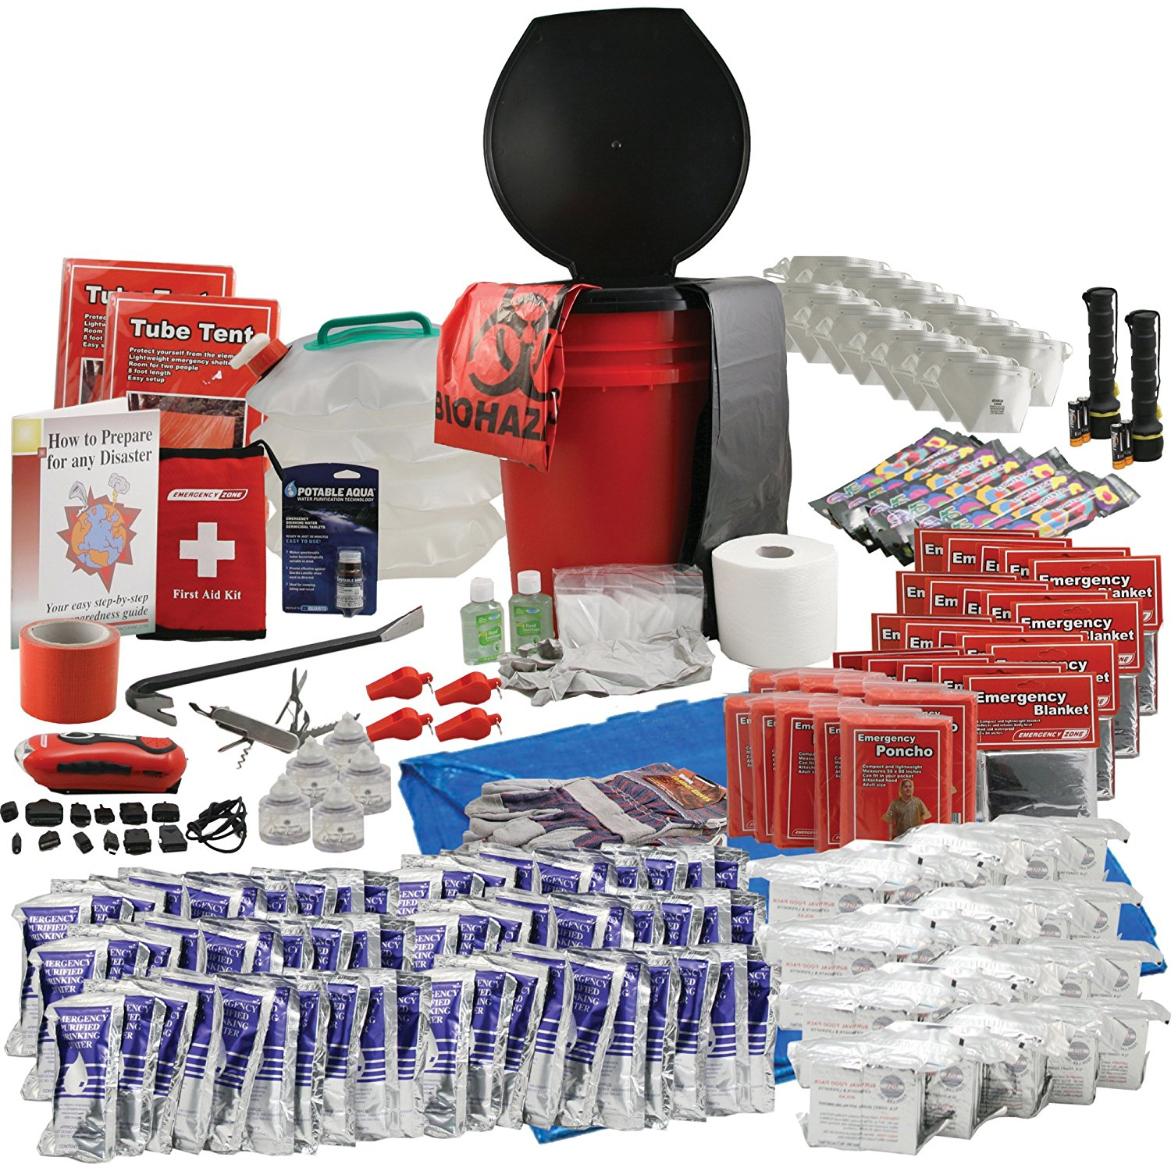
Whole Office Kit
Multiple of each item
Flashlights
Pry bar
Food/water
Toiletries
Radio
Emergency blankets
Dust masks
Whistles
Gloves
Ponchos
Tents
First aid kits
Toilet

Slide 29
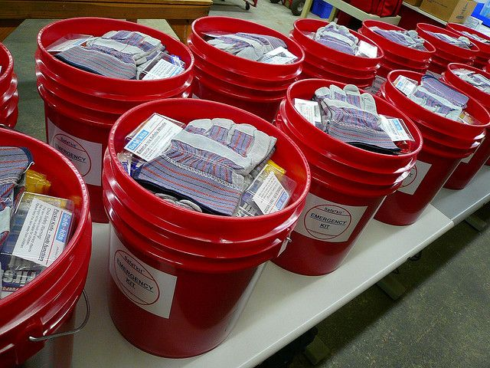
Emergency kit buckets

Slide 30
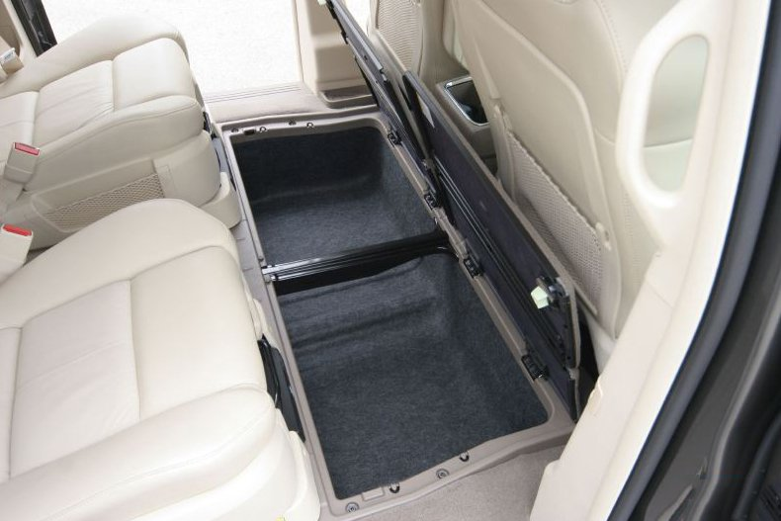
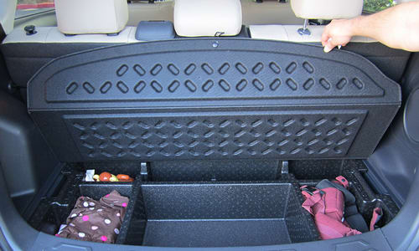
Vehicle Kit
Items needed to get home on foot
Clothes
Jacket/hoodie
Winter clothes
Extra shoes
Flashlight
Rope
Food/water
Tent or shelter
Tools
  Knife
  Basic tools
Fire starters
First aid kit

Slide 31
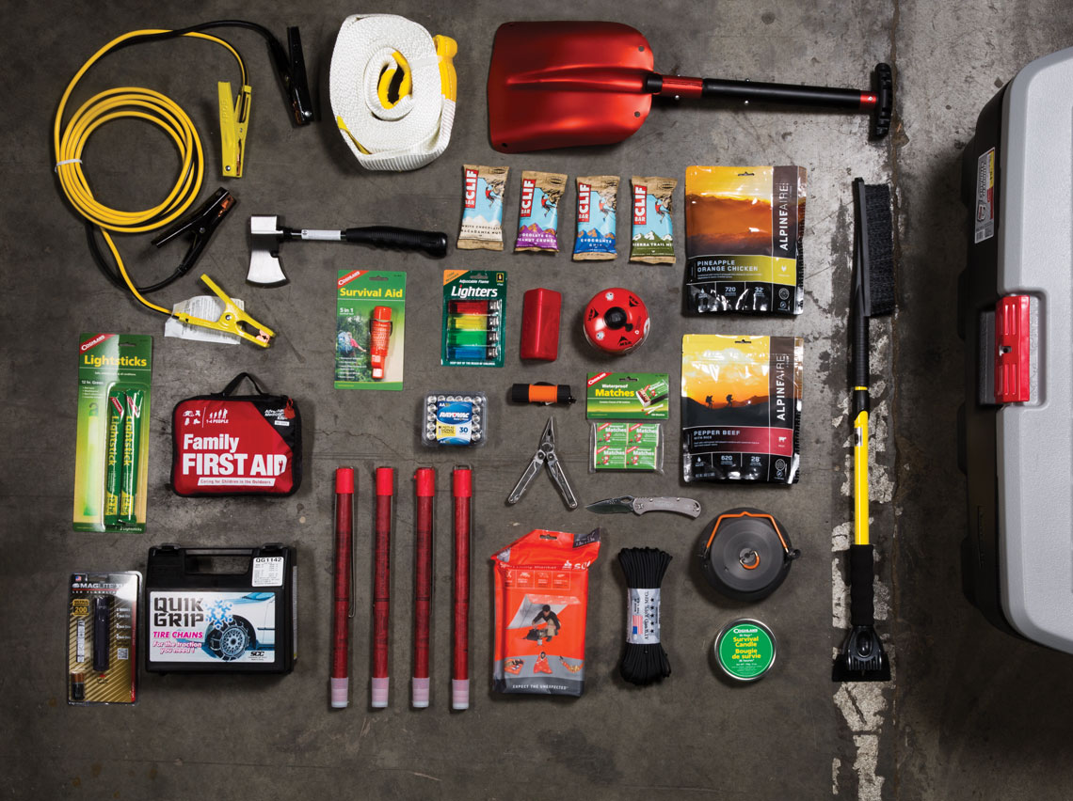
Vehicle Kit
Stuck in vehicle
Clothes
Jacket/hoodie
Winter clothes
Extra shoes
Flashlight
Gloves
Blanket
Food/water
Tools
  Knife
  Shovel
  Basic tools
First aid kit
Jumper cables
Tarp
Rope
Tow cable

Slide 32
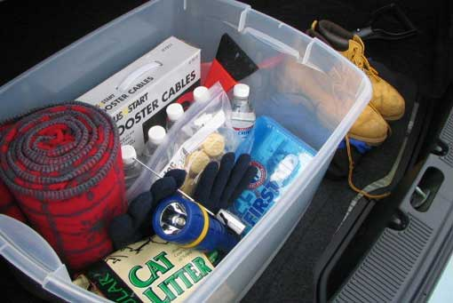
Vehicle Kit – Keep in Mind
Remember:
Due to extreme temperature changes, vehicle kits need to be checked more often
Rotate food and water
  If food or water tastes or smells odd, throw it out
Check medical supplies
Avoid expensive items

Slide 33
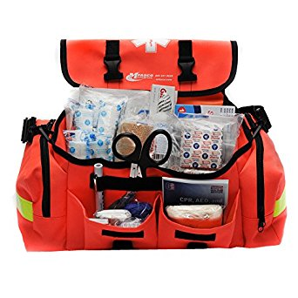
Additional Kits - Medical
Medical Kit
Household use only
Bandages
Medication
Splints
Gloves
Wound cleaning
Stock with items you are familiar with
If you don’t know how to use the item – don’t
Check items when you check other kits
Bandages, Band-Aids, ointments, saline can all go bad

Slide 34
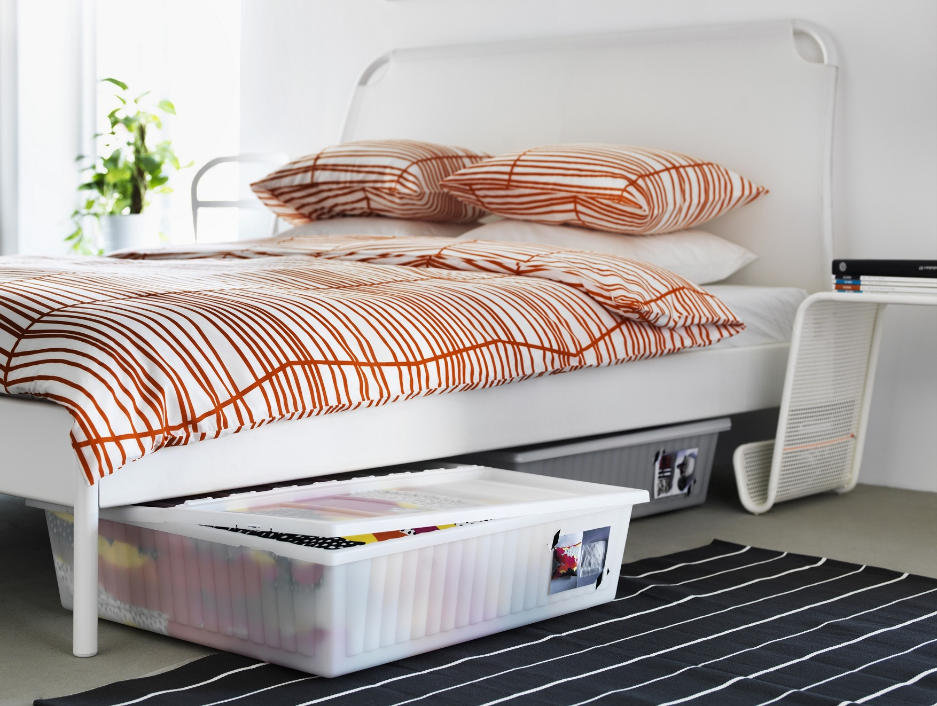
Additional Kits - Bedroom Kit
Bedroom Items
Clothes
Jacket/hoodie
Shoes
Pry bar
Flashlight
Radio
Rope
Dog leash/crate
Storage
Backpack in closet
Duffle bag in corner
Under bed storage

Slide 35
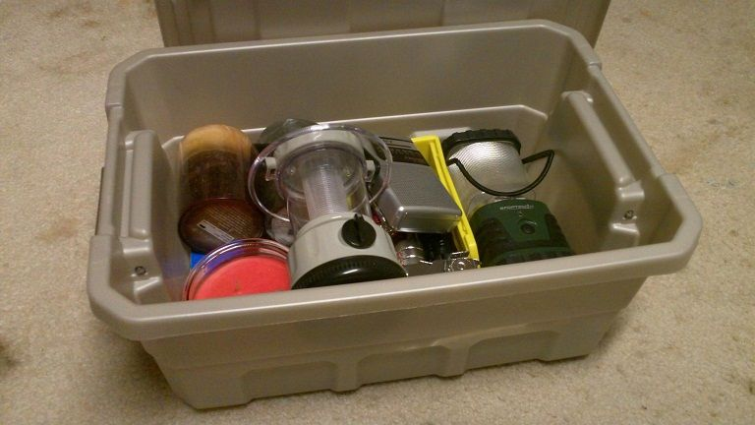
Additional Kits - Blackout
Blackout kit
Flashlights
Candles
Crank radio
Can opener
Matches/lighters
Glow sticks
Check batteries periodically
Charge items periodically

Slide 36
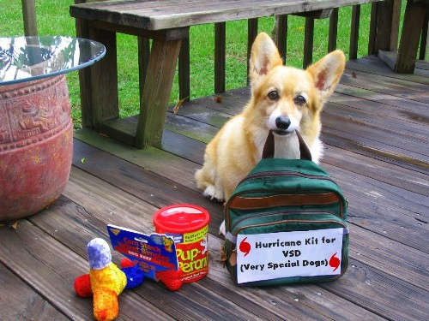
Additional Kits – Pet Kit
Pet Kit
Rotate bags of food
Water storage for pets
Toys
Treats
Leashes
Crate
Medications
Cold weather gear
Rain gear
Bedding
http://www.campbellvillagevet.com/resource-disaster.html

Slide 37



Extra Considerations
Entertainment
  Card games
  Books
  Board games
Tools
  Gloves
  Dust masks
  Hand tools (pry bars, hammer, etc.)
Cash
  Small bills
Shoring
  Wood
  Nails
Sweets
  Candy
  Gum
Maps

Slide 38

Have Your Kit Done
Now what?
Check your kits every couple months
  Rotate food/water
  Replace batteries
  Become familiar with items
  Check working order
  Charge rechargeable items
  Add or remove items as needed (upgrades)

Slide 39

Questions?

