Slide 1

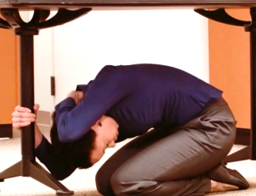
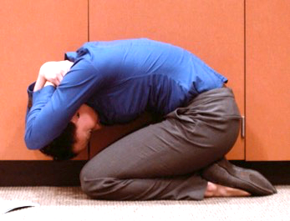
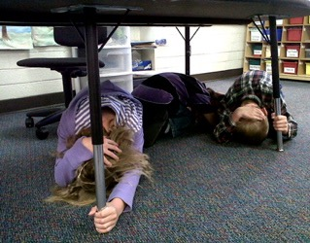
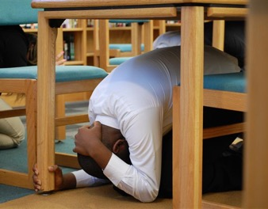
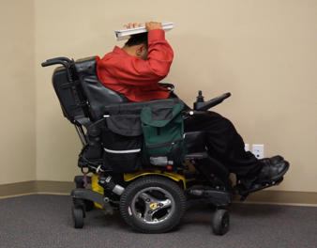
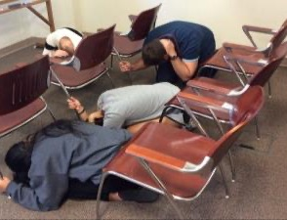
Great ShakeOut Earthquake Drills
Notes:
(First slide to show participants)

Slide 2
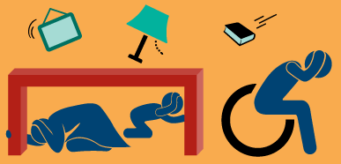
Great ShakeOut Earthquake Drill
Earthquakes may happen anytime and almost anywhere.
Most injuries caused by earthquakes are from falling or flying objects.
It is important to practice how to be safe!
Today we are joining millions of people
who are practicing earthquake safety!
Notes:
Drill leader: Visit ShakeOut.org to see the current number of participants in your area, for the entire U.S., and worldwide.

Slide 3
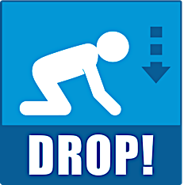



If a Table or Desk is Nearby
Drop where you are, onto your hands and knees. Cover your head and neck with one arm and hand. Then crawl underneath the table or desk for additional shelter. Stay on your knees and bend forward to protect vital organs. Hold On to your shelter with one hand Keep covering your head/neck with your other hand.
Notes:
Drill leader: Read the text; the next slide is if there is nothing to get under.

Slide 4
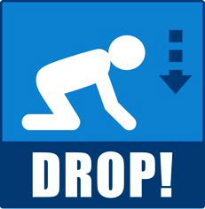



If There is Nothing to Get Under
Drop where you are, onto your hands and knees. Cover your head and neck with one arm and hand. Then crawl next to a wall, away from any windows. Stay on your knees and bend forward to protect vital organs. Hold On to your head and neck with both arms/hands.
Notes:
Drill leader: The purpose of getting next to a wall is so objects that may fly or fall can only hit you from one side.

Slide 5

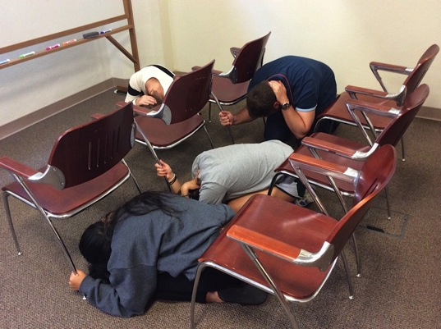
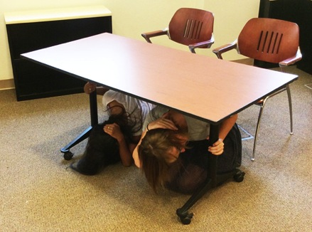
If in a Classroom, Auditorium, or Laboratory
In a CLASSROOM OR AUDITORIUM:
Drop to the floor where you are.
Cover your head and neck with one arm/hand.
Nearby tables or desks: crawl underneath and Hold On to your shelter with your free hand.
Rows of chairs: get between the rows and Hold On to a chair with your free hand.
Alternative: get next to a wall with no windows and cover your head and neck with both arms/hands.
In a LABORATORY:
Step back from the lab table.
Drop to the floor on your knees next to a wall, away from glass and other hazards if possible.
Cover your head and neck with your hands and arms.
Hold On to something sturdy if possible.
Notes:
Drill leader: Classrooms, auditoriums, laboratories, etc. can have very distinct layouts. Participants should consider how best they can protect themselves from falling of flying objects in these spaces.

Slide 6
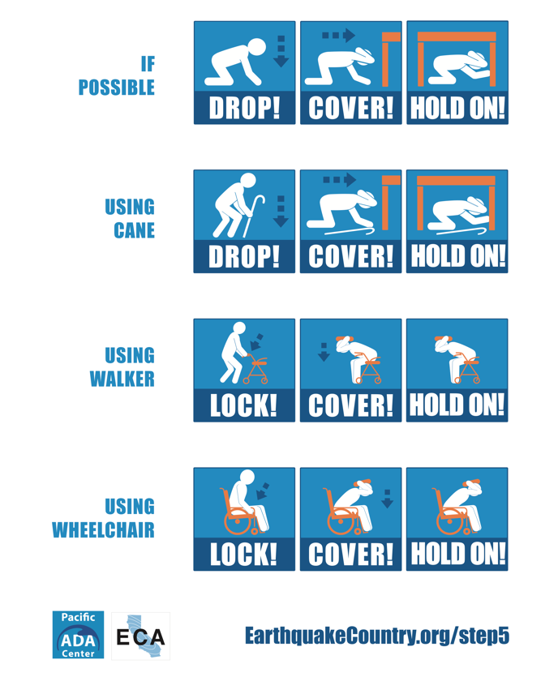
Adapt for Your Situation
If you cannot get back up again by yourself, do not drop to the ground.
If using a wheelchair or walker, lock the wheels (or set the brake).
Bend over and cover your head and neck with your arms/hands. You can also hold on to a book or other object over your head.
Instruct others how to assist you.
Notes:
Drill leader: More guidance for people with disabilities or other access & functional needs is at EarthquakeCountry.org/disability

Slide 7
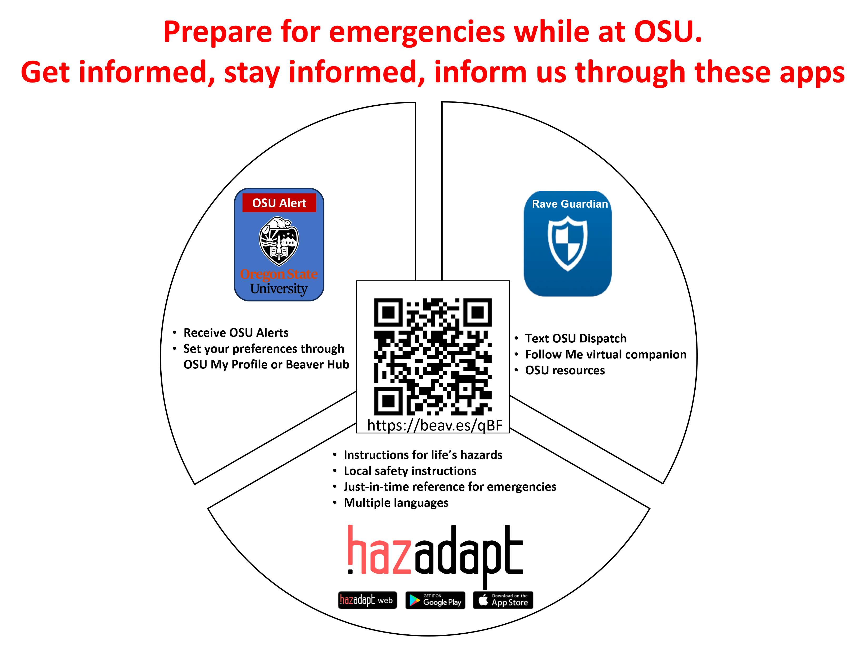
Apps

Slide 8
Time to ShakeOut!
This is an earthquake drill. Right now, DROP, COVER, AND HOLD ON.
DROP to the floor now. During a large earthquake, the ground might jerk strongly and knock you down.
Take COVER under something sturdy, to protect yourself from objects that might be thrown across the room.
HOLD ON to your shelter until the shaking stops.
If you can’t get under something, stay low and protect your head and neck with your arms.
Now look around. What objects might fall or be thrown at you, that you should secure in place before a real earthquake?
Finally, a strong earthquake may generate a tsunami. If you're near the ocean during an earthquake, DROP, COVER, and HOLD ON, then quickly walk to high ground after the shaking stops.
This drill is over. Thank you for taking part in the Great ShakeOut!
Notes:
Drill leader: This is the text of the recording, if you prefer to read it to your students.

Slide 9
Discussion
What did you learn by practicing how to protect yourself?
What might fall on you or others if a real earthquake happened now right now? How might you move or secure those items so they won’t cause injury?
If power goes out in your area for several days or more, how long will cell phone batteries last? Do you or your family have a “powerbank” charger for phones?
How would you contact your family or others? Communicating via text or apps may be possible when calls are not,
What should you have in a disaster supplies kit?
Learn more: Ready.gov or EarthquakeCountry.org/sevensteps
Notes:
Drill leader: You can choose which questions to ask or delete some depending on available time.

